Slide 1
Using neural networks to decode EEG and read your thoughts
Building a yes/no classifier to help people with central nervous system injuries communicate

Slide 2
We are seeking to replicate and improve on the results of a recent scientific study
The original study sought to create the best yes/no binary predictor for nine participants with spinal cord injuries or major strokes.
Each participant came for two sessions several days apart
At each session they wore an array of thirty EEG electrodes
And most importantly for our purposes – they released the raw data so we can use it to try and replicate and improve on their results
Can we build a model to accurately differentiate between two of those five trial types?

Slide 3
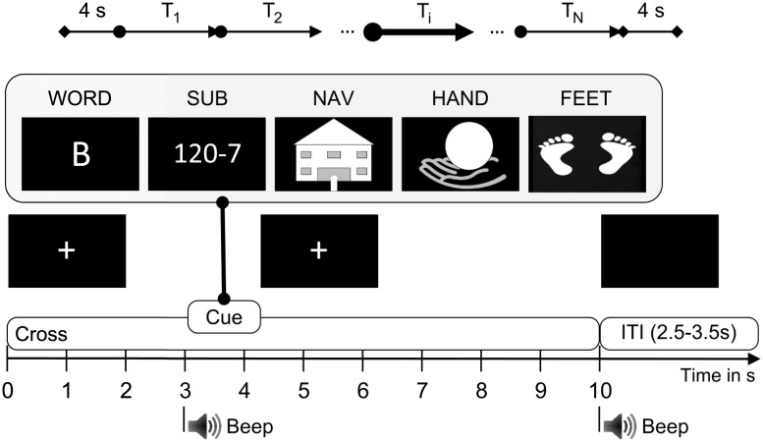
Details of the original study
Source: Reinhold Scherer, Josef Faller, Elisabeth V. C. Friedrich, Eloy Opisso, Ursula Costa, Andrea Kübler, and Gernot R. Müller-Putz:
Individually Adapted Imagery Improves Brain-Computer Interface Performance in End-Users with Disability

Slide 4
Finding a yes/no predictor against 50% baseline accuracy
?
Source: Reinhold Scherer, Josef Faller, Elisabeth V. C. Friedrich, Eloy Opisso, Ursula Costa, Andrea Kübler, and Gernot R. Müller-Putz:
Individually Adapted Imagery Improves Brain-Computer Interface Performance in End-Users with Disability

Slide 5
200 trials conducted each day, 80 data points in each pairwise combination
Day 1
Trial type | Times conducted
Word | 40
Subtraction | 40
Navigation | 40
Hand | 40
Feet | 40
Total | 200
80 data points for each pairwise combination, split into train and test
=
=
Can’t look at it until testing final model
Day 2

Slide 6
A number of signal processing methods were tried to improve signal quality
Frequency filtering (low pass and high pass filters)
Use signal-space projections (SSP) and independent component analysis (ICA)
Baseline correction
Decimate data (e.g., take every 2nd, 4th, and 8th samples)
Drop trials based on peak-to-peak amplitude or lack of peak to trough amplitude
Common Spatial Patterns (CSP) to reduce dimensionality of data

Slide 7
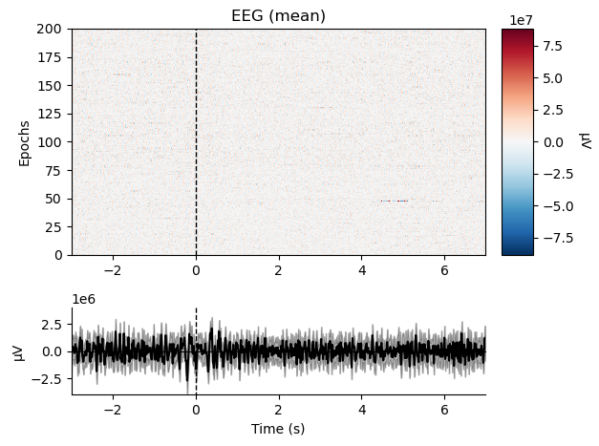
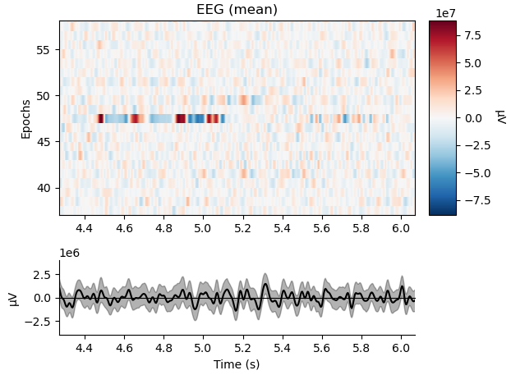
Dropping trials, visualized

Slide 8
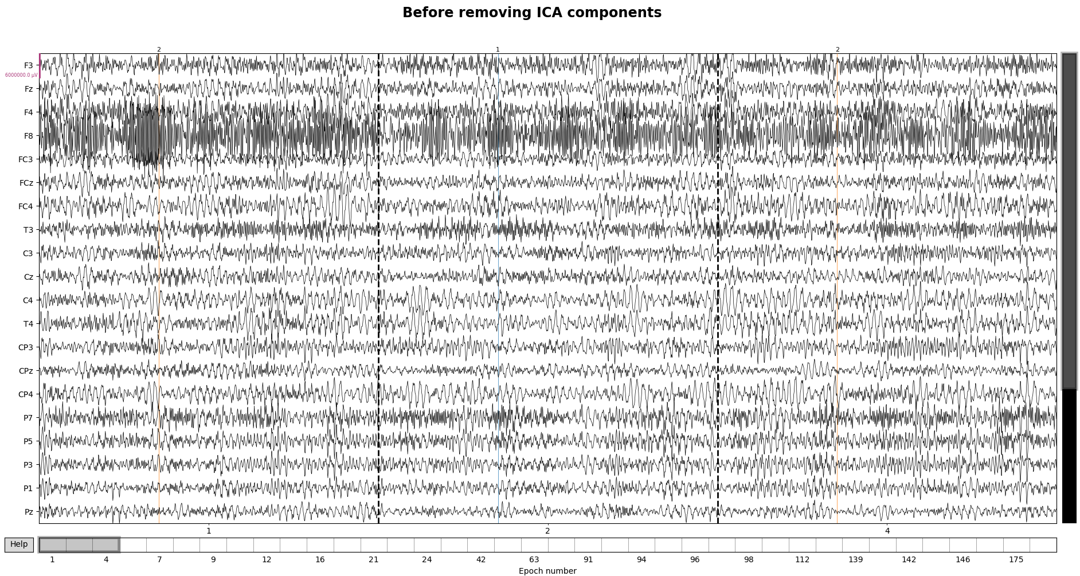
ICA visualized (1 of 2)

Slide 9
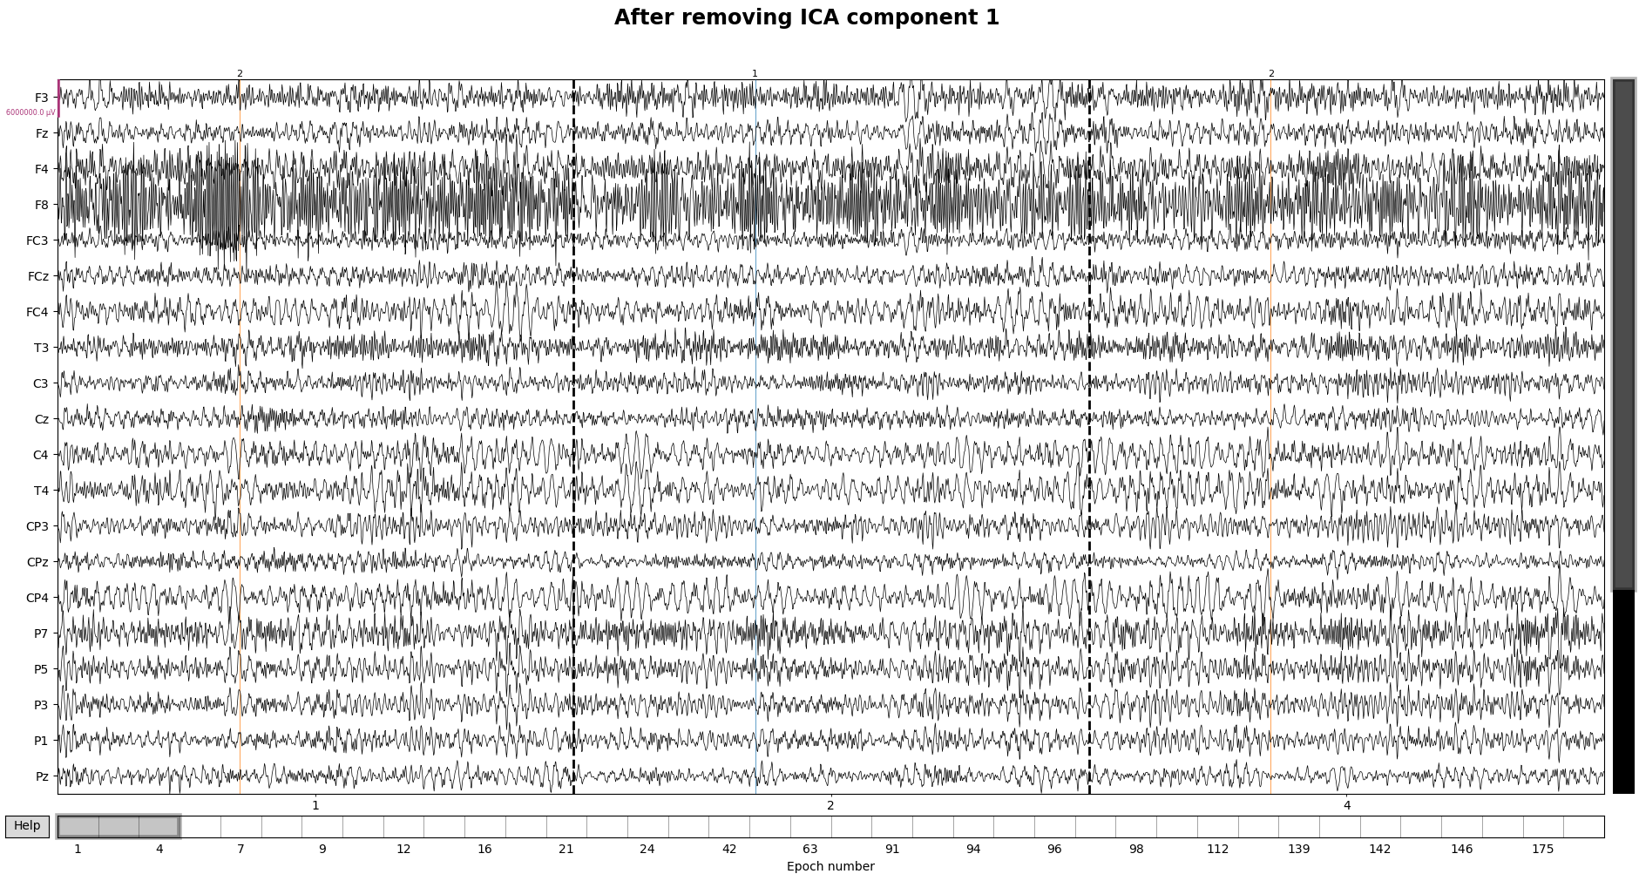
ICA visualized (1 of 2)

Slide 10
I combined several methods to try and solve the problem – unique model for each subject
Convolutional Neural Network (big filters)
Convolutional Neural Network (small filters)
LDA + Common Spatial Patterns (CSP)
Neural Network + CSP
Neural Network
Final prediction for each trial

Slide 11
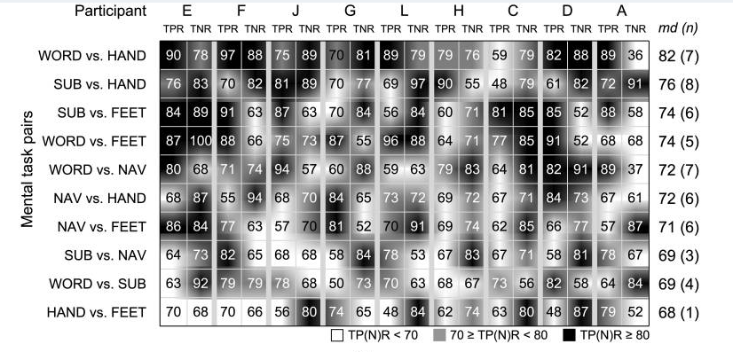
The original study achieved 80% average accuracy across the nine subjects
Source: Reinhold Scherer, Josef Faller, Elisabeth V. C. Friedrich, Eloy Opisso, Ursula Costa, Andrea Kübler, and Gernot R. Müller-Putz:
Individually Adapted Imagery Improves Brain-Computer Interface Performance in End-Users with Disability

Slide 12
Unfortunately I wasn’t able to match that accuracy on session 2 data
Subject | A |  | C |  | D |  | E |  | F |  | G |  | H |  | J |  | L
% Acc. (TPR, TNR) | 87 | 10 | 48 | 85 | 0 | 100 | 0 | 100 | 73 | 27 | 100 | 0 | 88 | 6 | 97 | 49 | 54 | 36
Extremely unbalanced positive vs negative accuracy rates show the model has not successfully adapted to the shift to session 2.
Overall average accuracy is only 55%

Slide 13
Next steps
Use different ensemble model – neural network is overfitting
Utilize a Reiman geometry method for a new L1 model
Supposed to outperform CSP on EEG problems
Implement a rebiasing method
Essentially using the first few trials of session 2 to adjust the model to the shifted EEG patterns
Make CNN models more generalizable
Resample the data (e.g., instead of looking at data from 0 - 5 seconds, create three sections of data 0 – 3 1 – 4 2 - 5)
Rerun analysis with fewer dropped channels
The key to success here is more data – I should drop as little as possible

